Slide 1
3.1.4 Struktur des Universums
  Astronomie
  Wahlfach
Supernovae Ia
E. Malz
ZPG Astronomie

Slide 2
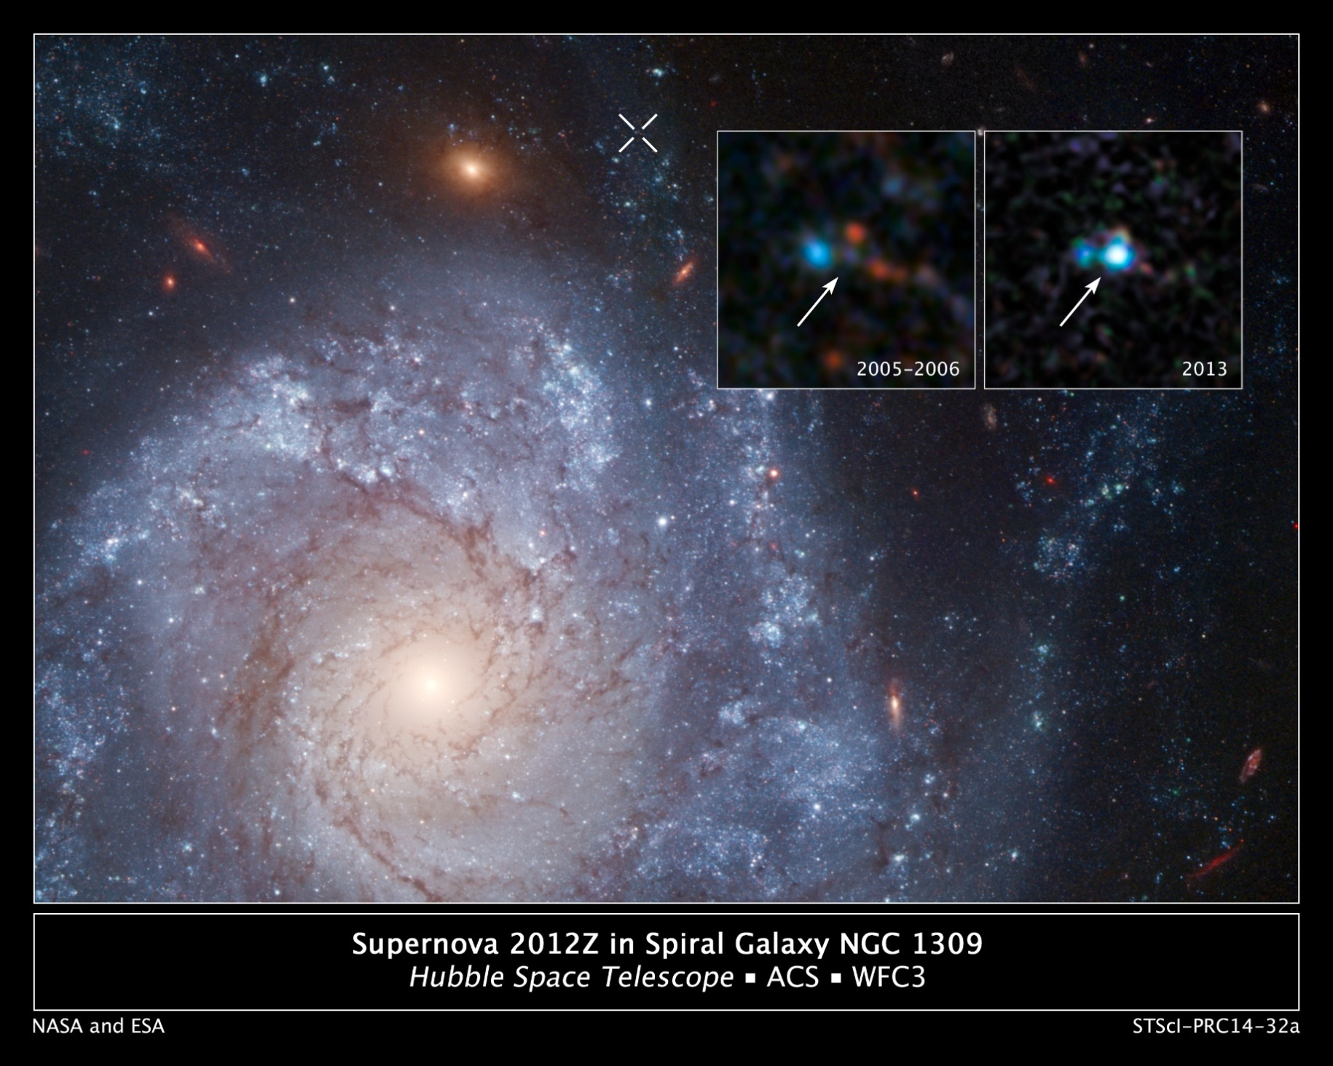
NGC 1309
28 Mpc
Bild: „Supernova 2012Z in spiral galaxy NGC 1309, annotatedNGC 1309
28 Mpc“ von NASA, ESA, C. McCully and S. Jha (Rutgers University), R. Foley (University of Illinois), and Z. Levay (STScI)
Acknowledgment: Hubble Heritage Team (STScI/AURA), and A. Riess (JHU/STScI) via https://commons.wikimedia.org/wiki/File:Supernova_2012Z_in_spiral_galaxy_NGC_1309,_annotated.jpg
[CC BY 4.0]

Slide 3
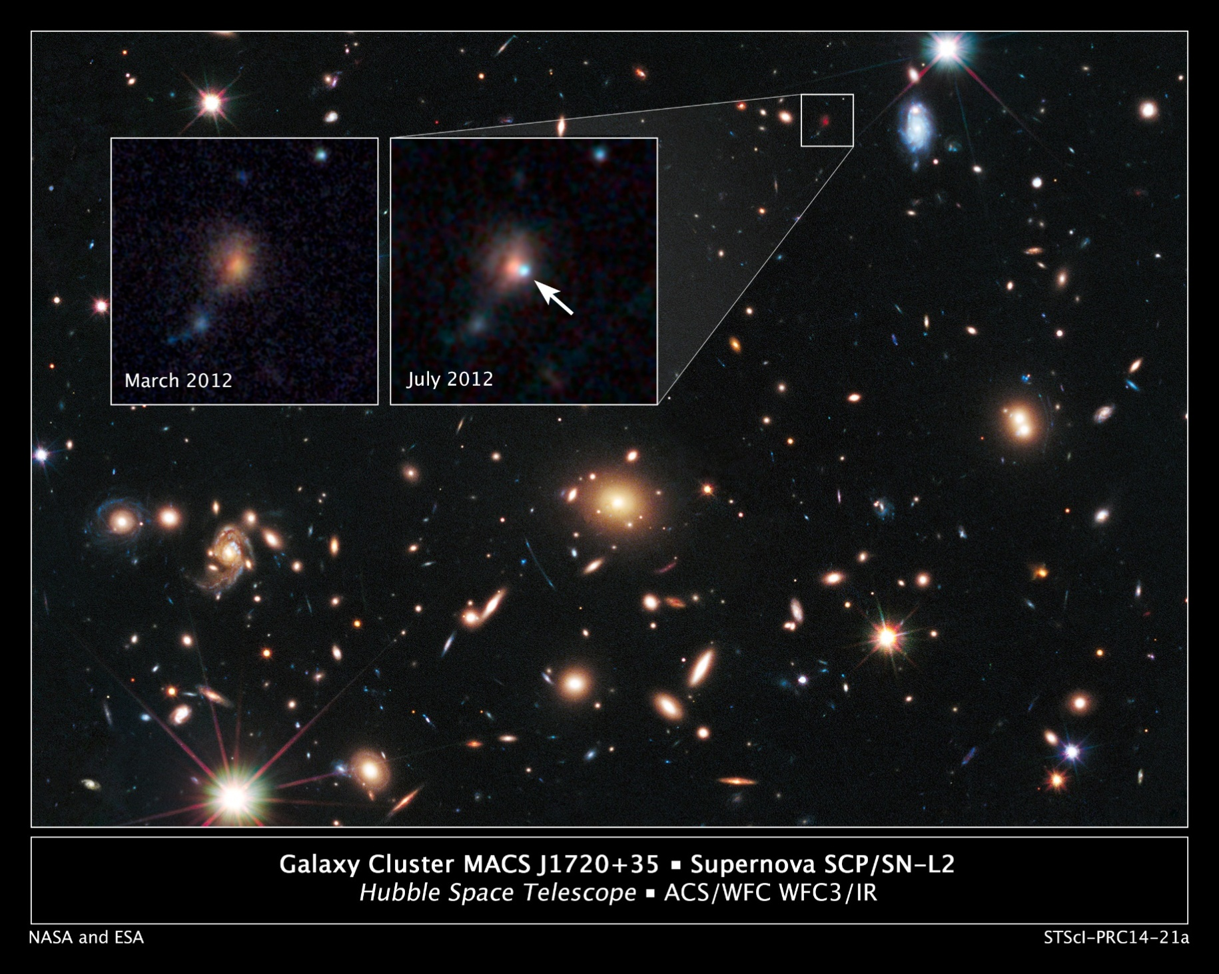
NGC 1309
780 Mpc
Bild: „Galaxy Cluster MACS J1720+35“ von NASA, ESA, S. Perlmutter (UC Berkeley, LBNL), A. Koekemoer (STScI), M. Postman (STScI), A. Riess (STScI/JHU), J. Nordin (LBNL, UC Berkeley), D. Rubin (Florida State), and C. McCully (Rutgers University) via https://esahubble.org/images/heic1409b/
[CC BY 4.0]

