Slide 1
3.1.4 Struktur des Universums
  Astronomie
  Wahlfach
Galaxienklassifikation
E. Malz
ZPG Astronomie

Slide 2
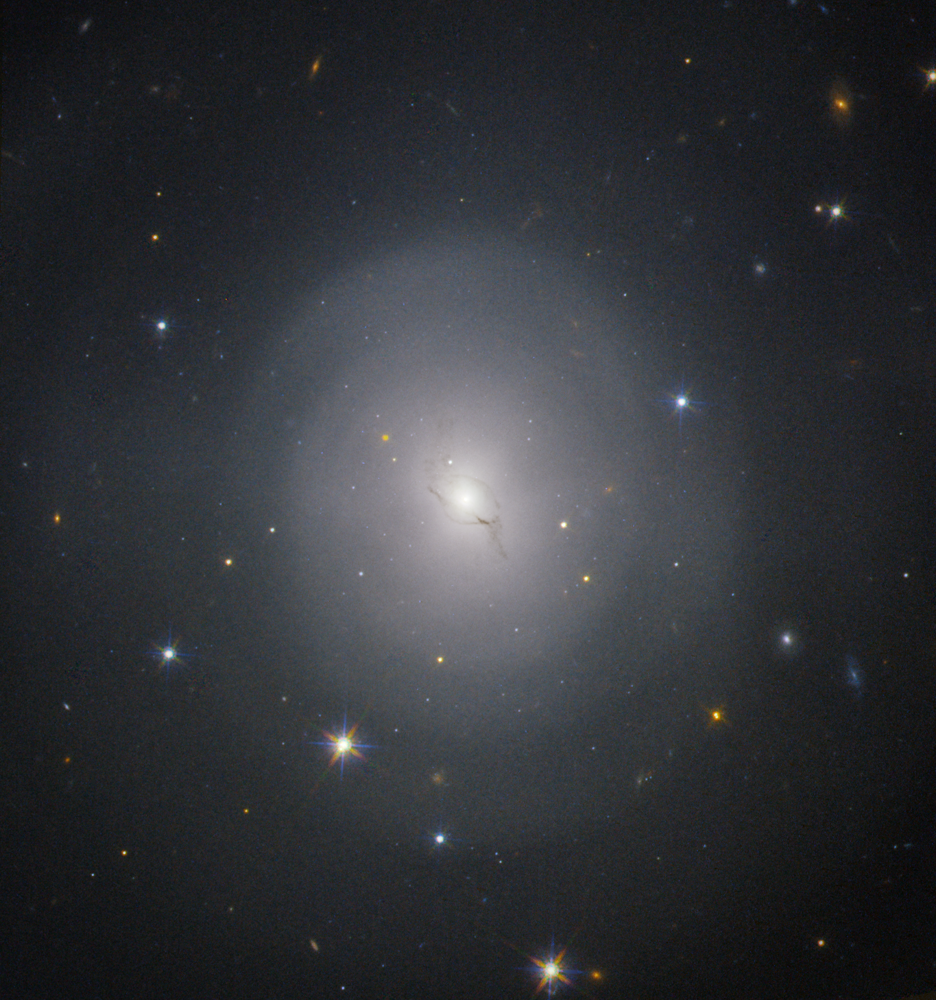
NGC 4993
Elliptische Galaxie
40 Mpc
Bild: „galaxy NGC 4993 “ von NASA and ESA via https://svs.gsfc.nasa.gov/12740 [Public Domain (PD-USGov)]

Slide 3
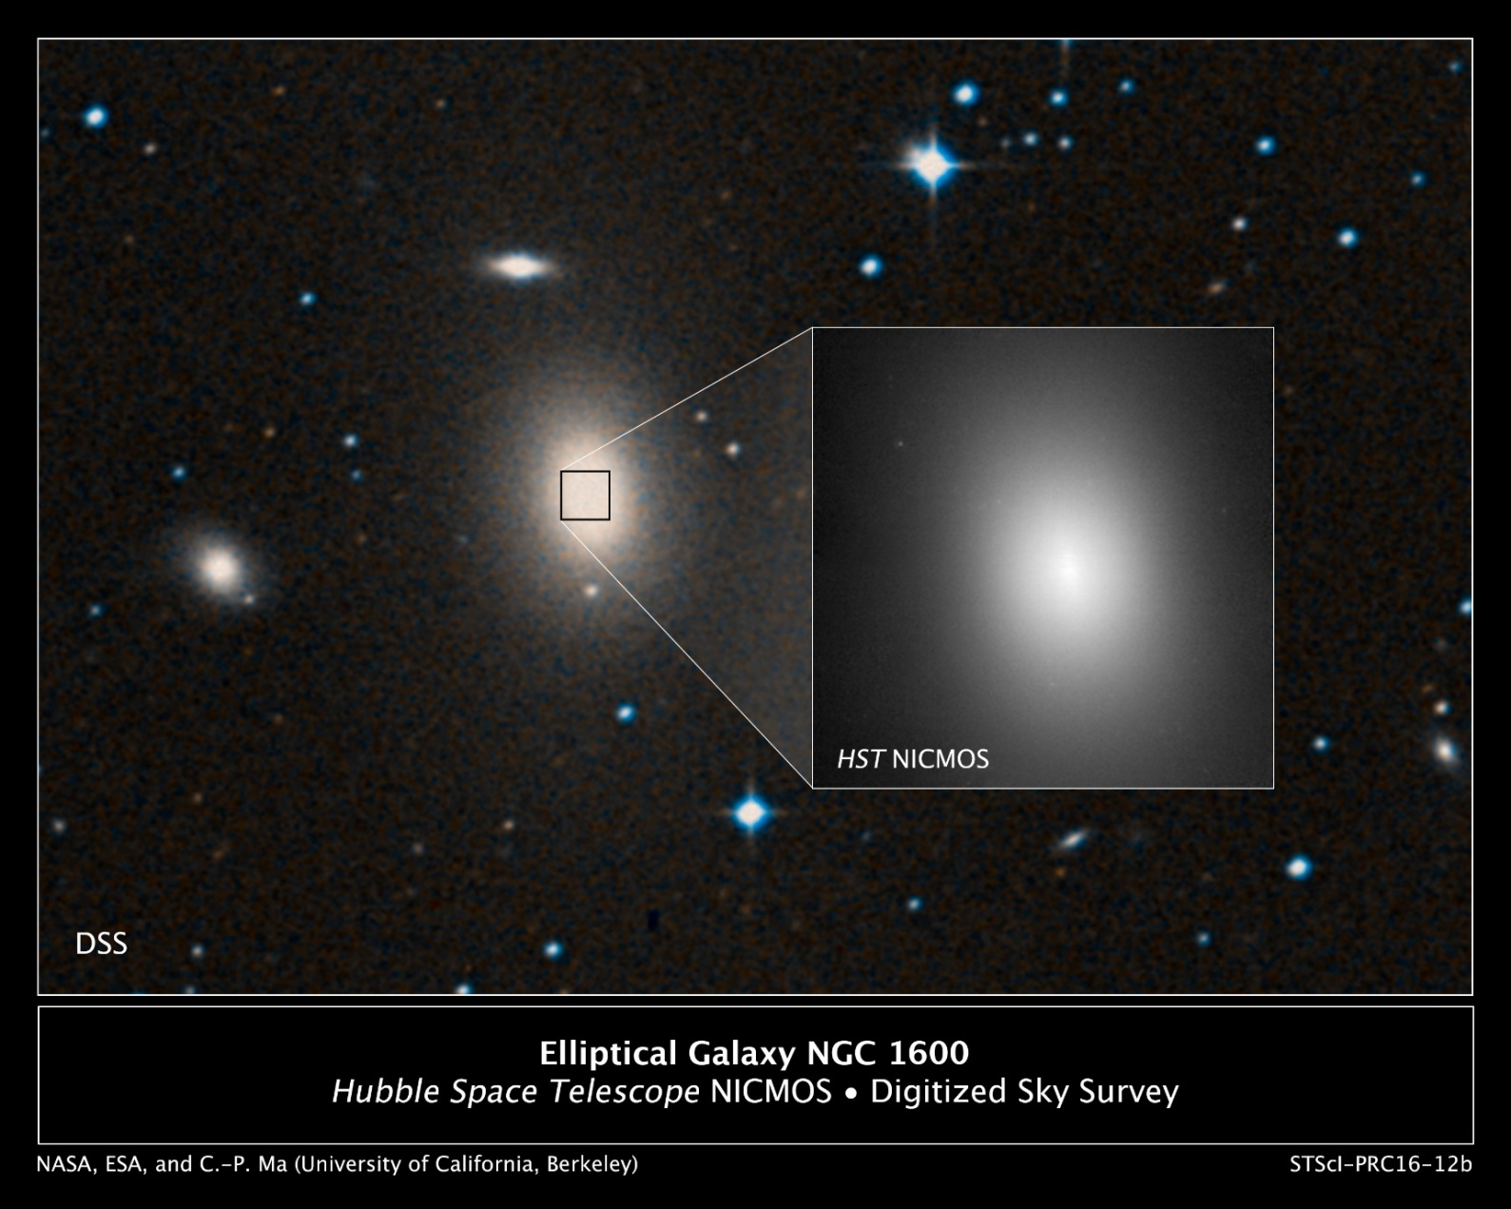
NGC 1600
Elliptische Galaxie
64Mpc
Bild: „Elliptical Galaxy NGC 1600“ von NASA, ESA an C.-P. Ma (University of California, Berkeley) via https://news.berkeley.edu/wp-content/uploads/2016/04/HubbleNGC1600-collage.jpg
[Public Domain]

Slide 4
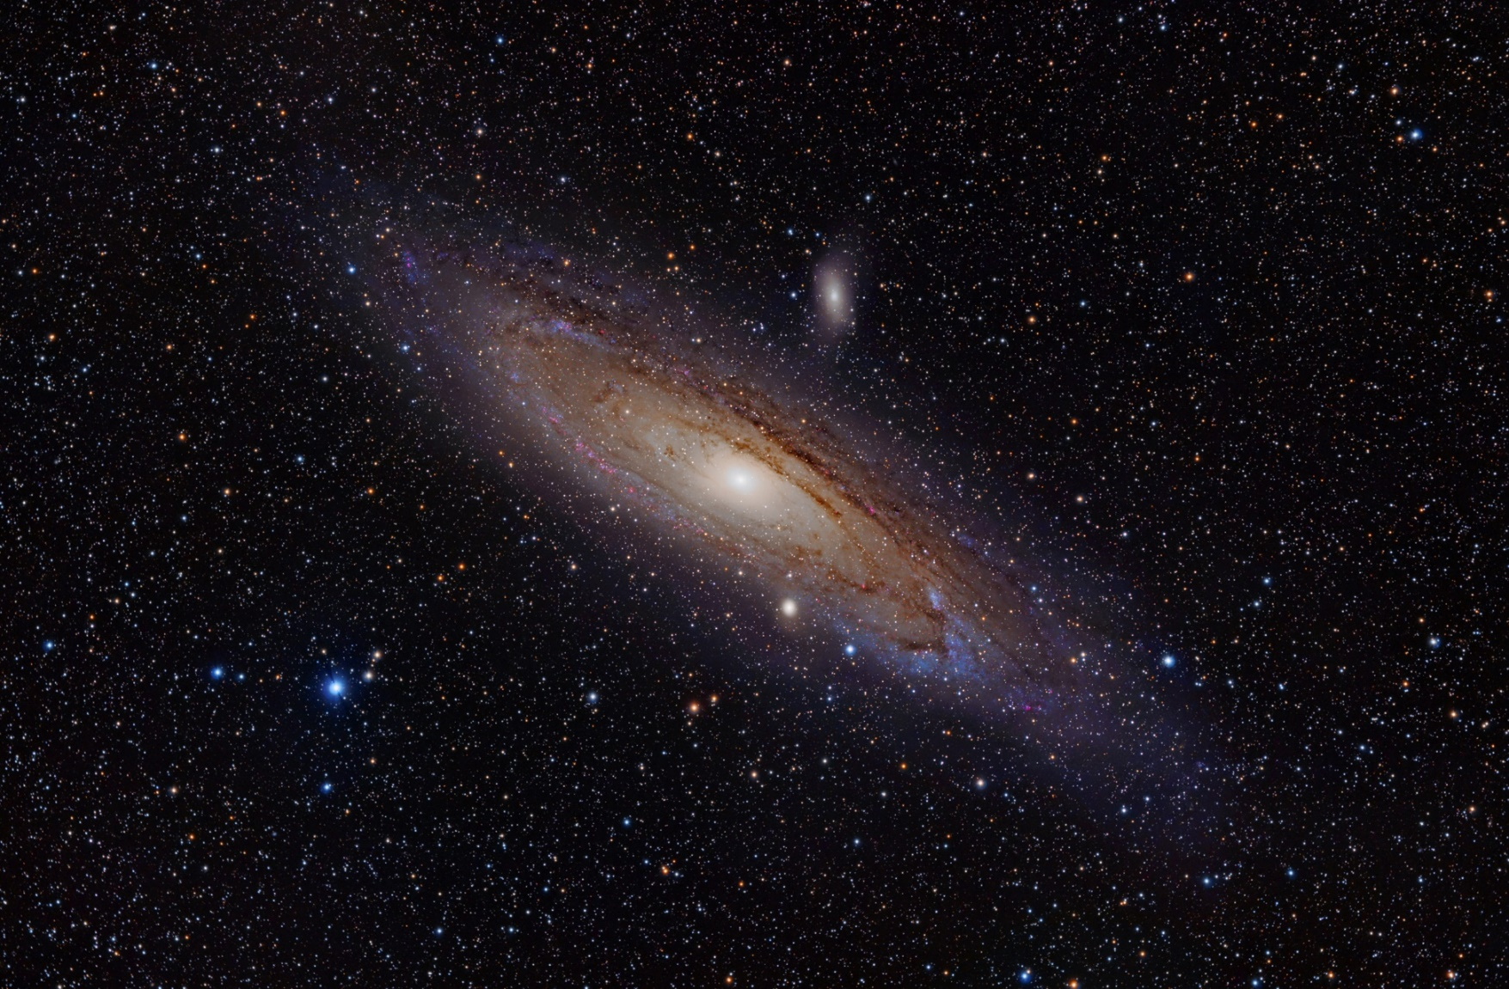
M31
Spiralgalaxie
760 kpc
Bild: „Andromeda Galaxy (with h-alpha) rotated” von Adam Evans via https://commons.wikimedia.org/wiki/File:Andromeda_Galaxy_(with_h-alpha)_rotated.jpg [CC BY 2.0]

Slide 5
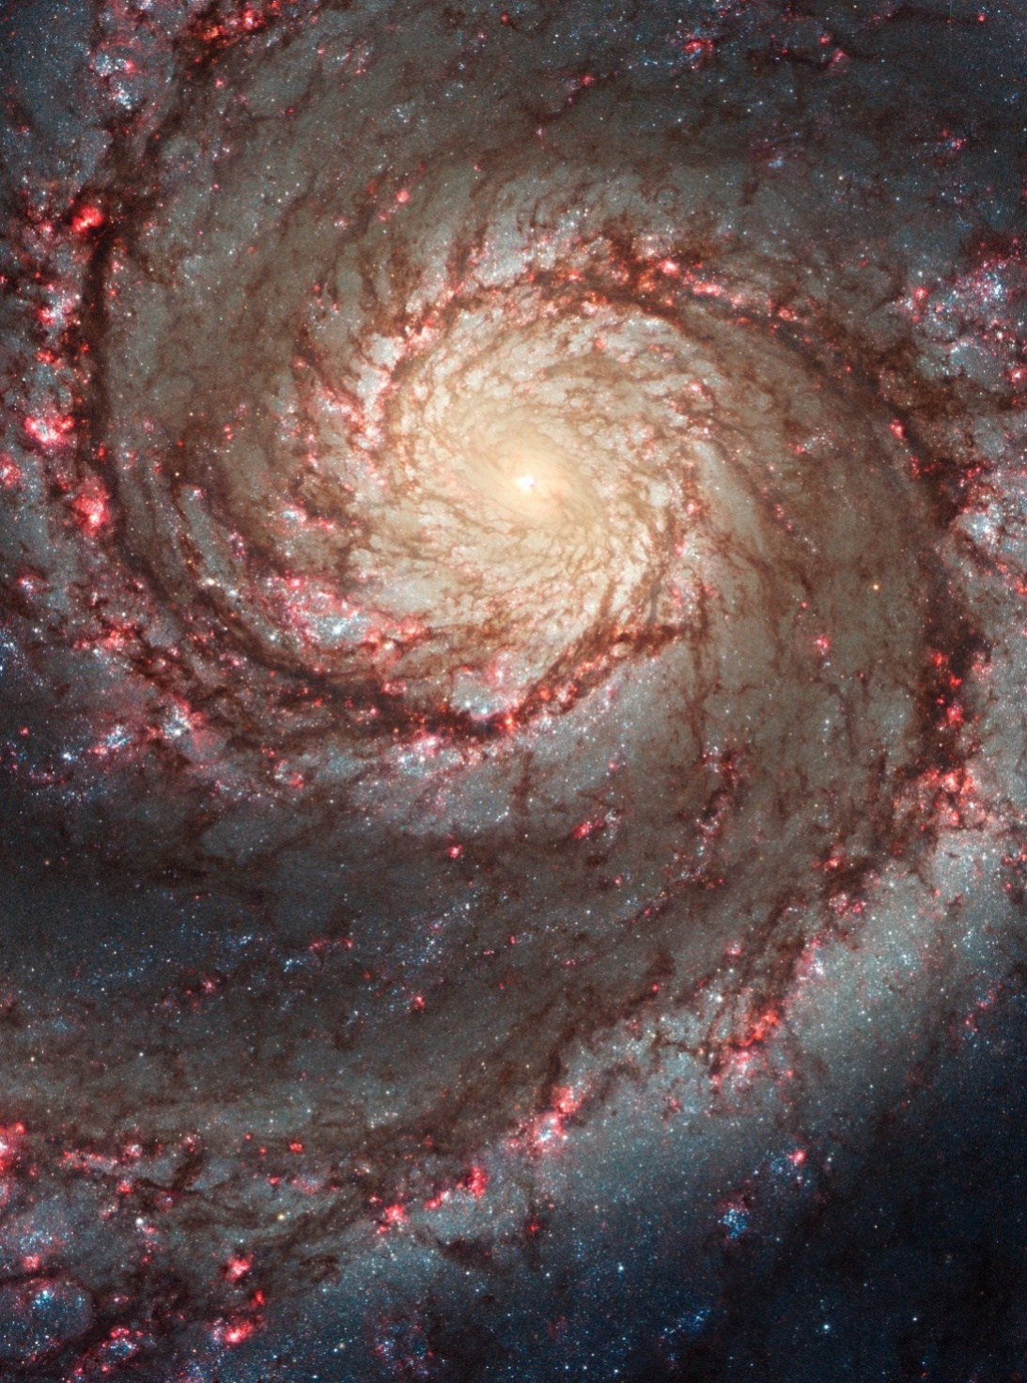
M51
Spiralgalaxie
9,6 Mpc
Bild: „The Two-faced Whirlpool Galaxy“ von NASA, ESA, S. Beckwith (STScI), and the Hubble Heritage Team (STScI/AURA) via https://www.flickr.com/photos/gsfc/5352955200/ [CC BY 2.0]

Slide 6
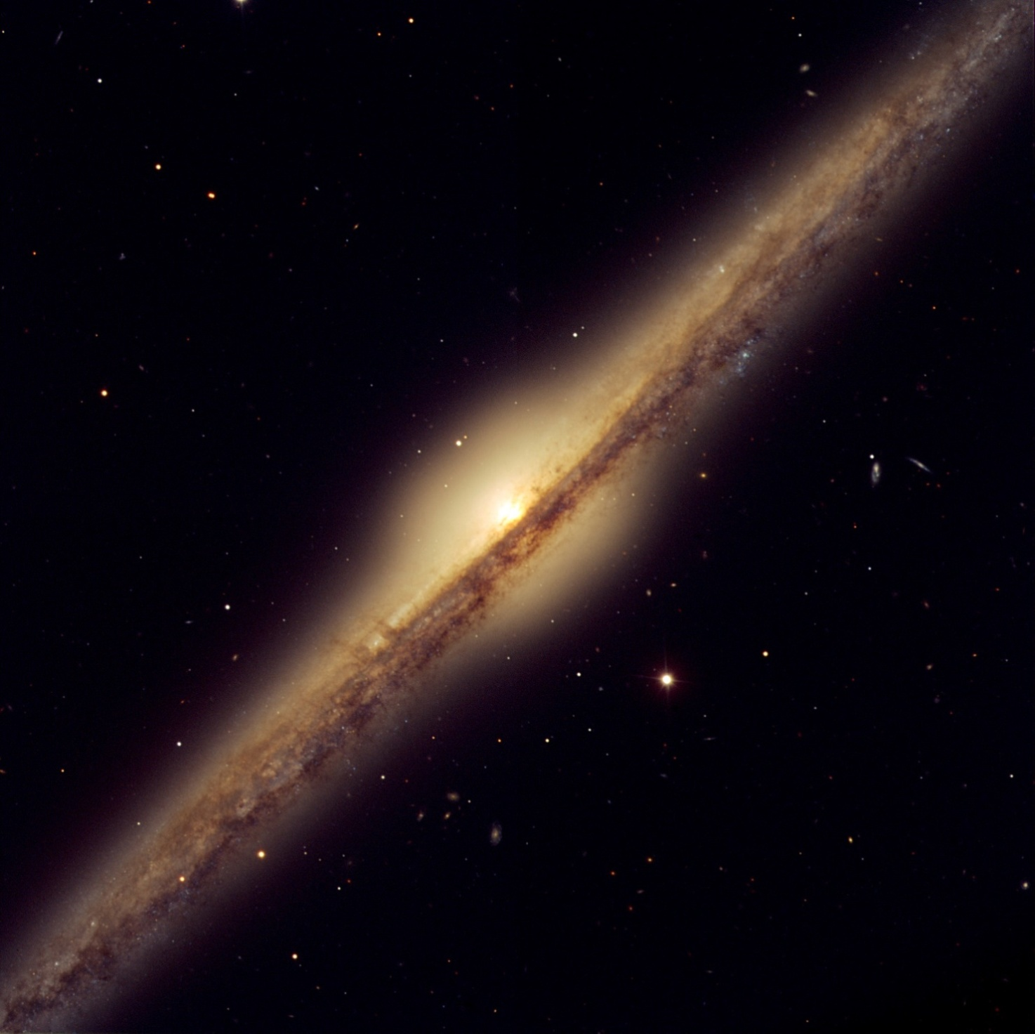
NGC4565
Spiralgalaxie
16,8 Mpc
Bild: „Spiral galaxy NGC 4565“ von ESO via https://www.eso.org/public/news/eso0525/ [CC BY 4.0]

Slide 7
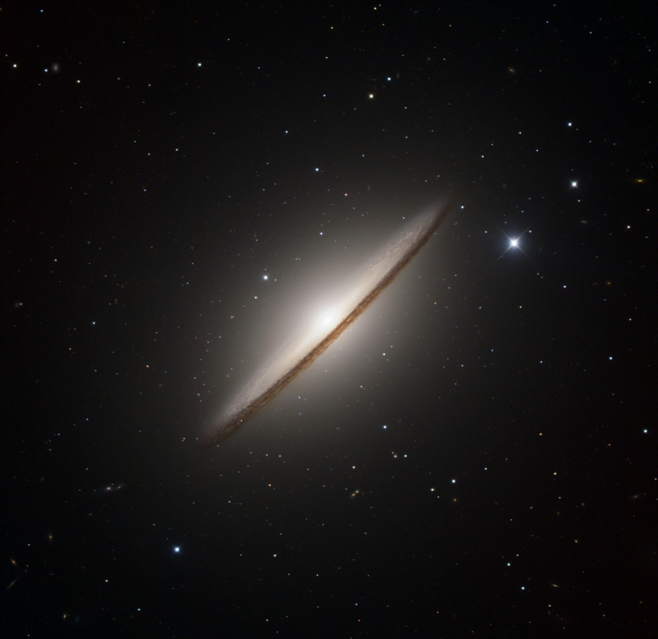
M104
Spiralgalaxie
12,4 Mpc
Bild: „The Sombrero Galaxy“ von ESO/IDA/Danish 1.5 m/R. Gendler and J.-E. Ovaldsen via https://www.eso.org/public/images/sombrero/ [CC-BY 4.0]

Slide 8
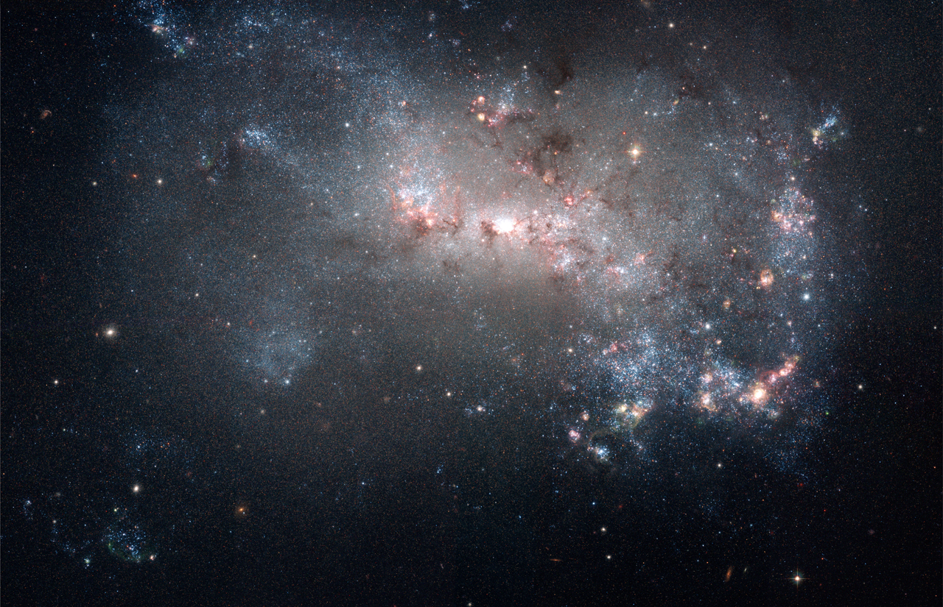
NGC4449
Irreguläre Galaxie
4 Mpc
Bild:“Starburst in NGC 4449 (captured by the Hubble Space Telescope)“ von NASA, ESA, A. Aloisi (STScI/ESA), and The Hubble Heritage (STScI/AURA)-ESA/Hubble Collaboration via https://commons.wikimedia.org/wiki/File:Starburst_in_NGC_4449_(captured_by_the_Hubble_Space_Telescope).jpg [Public Domain]

Slide 9
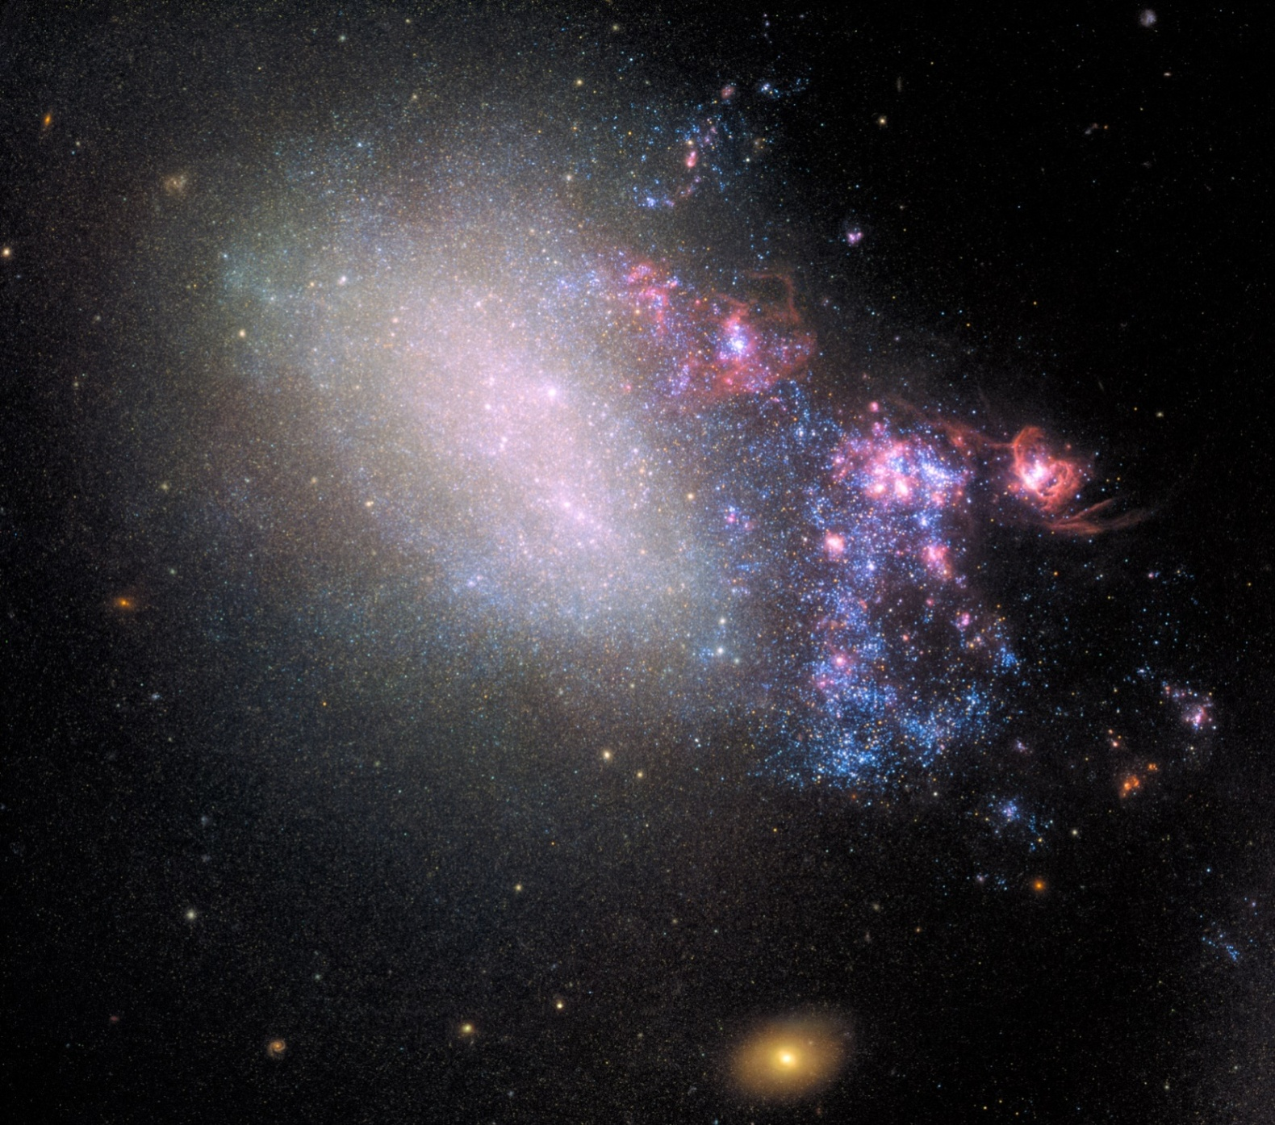
NGC4485
Irreguläre Galaxie
7,7 Mpc
Bild: „NGC 4485 “ von ESA/Hubble, NASA; Acknowledgement: T. Roberts (Durham University), D. Calzetti (University of Massachusetts) and the LEGUS Team, R. Tully (University of Hawaii) and R. Chandar (University of Toledo) via https://esahubble.org/images/heic1910a/ [CC BY 4.0]

